Slide 1


Melbourne AirBnB
2019 vs 2020

Slide 2

Project Brief
Our project aimed to look at available data for Melbourne AirBnB listings across 2019 and 2020 to identify trends in availability, room types offered and whether price or other factors affect a host’s review score.
Specifically, we looked at:
Which Melbourne areas have the most AirBnB listings
Which Melbourne areas see the most bookings
What room types does AirBnB have in Melbourne
How does the price of these room types vary across suburbs
Does price correlate to a high review score
Does price correlate to the number of nights a property is booked
Does a host responding to messages correlate to the number of nights their property is booked

Slide 3

Data Used
There were two datasets used for this project:
https://www.kaggle.com/tylerx/melbourne-airbnb-open-data
This dataset was compiled from the Inside AirBnB website on 7 December 2018
It shows all active listings for AirBnB and the next 12 months of their calendar (i.e. availability in 2019 for the properties)
It also contains a range of summary data and other information about the host
https://www.kaggle.com/nadyafed/melbourne-airbnb-2020
This dataset was also compiled from the Inside AirBnB website, this dataset was created on 20 August 2020
Inside AirBnB - http://insideairbnb.com/get-the-data.html
Inside AirBnB Data Dictionary - https://docs.google.com/spreadsheets/d/1iWCNJcSutYqpULSQHlNyGInUvHg2BoUGoNRIGa6Szc4/edit#gid=982310896

Slide 4
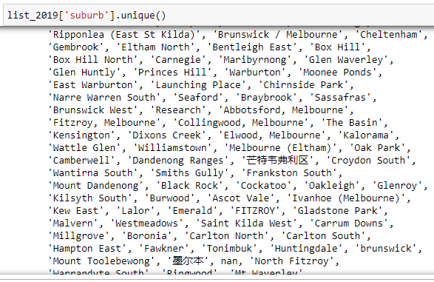
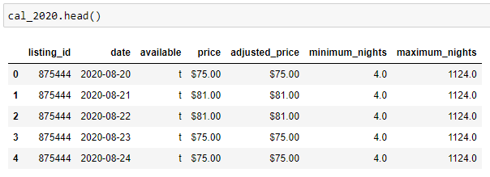
Title
Limitations of the Datasets
The largest limitation of the available data is that it’s a snapshot only. AirBnB did not have available ongoing historical data for public use, and that would have been too large to work with, so our data has two different start dates rather than looking at identical moments in time.
The second large limitation was the amount of data entered by the AirBnB hosts themselves. As a web-scraped set of data, there is a large volume of data which needed to be removed as it caused inaccuracies.
Availability is given as a True/False in the AirBnB calendar. However, while we assume this to be a booking, it can also simply indicate that the listing was made unavailable by the host during those dates.
Pricing data presents extreme outliers within the dataset, this is likely because some bookings are only made available for long term stays, but their host has listed that price as the daily price.

Slide 5
Which Melbourne Areas have the most AirBnB listings
Local Government Area | 2019 Listings | 2020 Listings | Change in Listings from 2020 and 2019
Melbourne | 7368 | 6174 | -1194
Port Phillip | 2808 | 2498 | -310
Yarra | 2049 | 1578 | -471
Stonnington | 1621 | 1369 | -252
Moreland | 967 | 863 | -104
The top 5 local government areas in the 2019 data were:
Melbourne
Port Phillip
Yarra
Stonnington
Moreland
These also remained the most populated with listings in the 2020 data, as seen in the table on the right.
The total 2019 listings were 22,895 and 2020 had 20,420.
This means that AirBnB lost 2,475 listings between the two data scrapes.

Slide 6
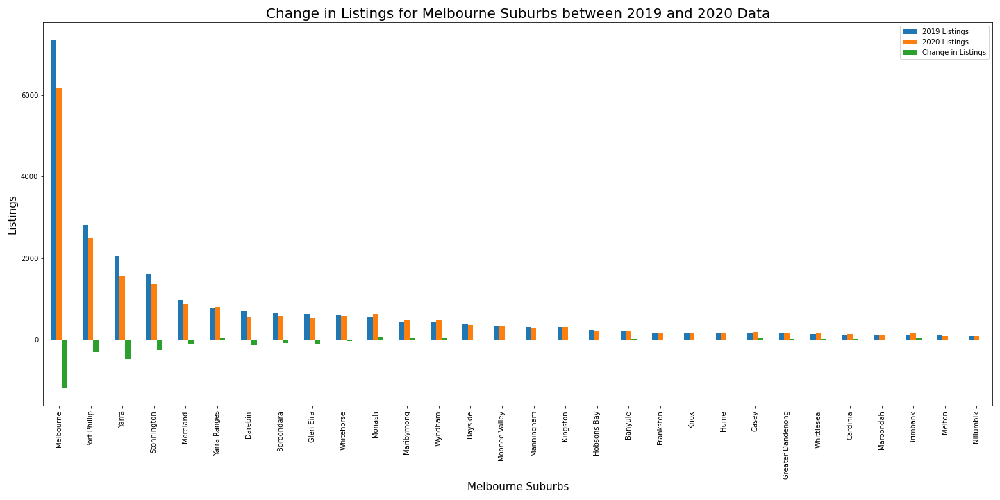

Slide 7
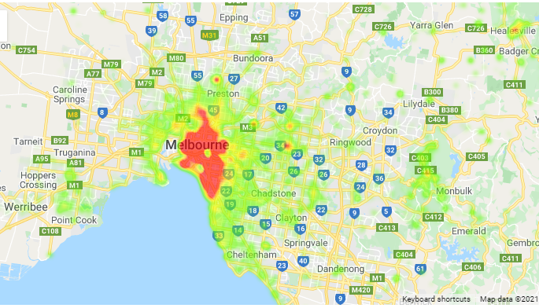
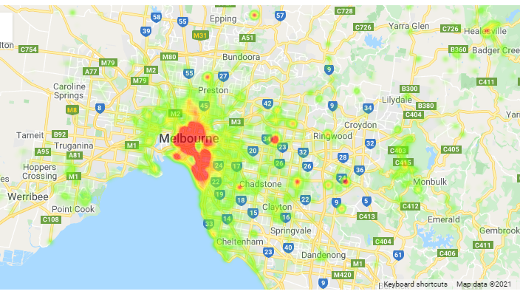
Listings – Heatmap of Prices

Slide 10

Title:
Final Comments
We will also take questions.

Slide 11

THANK YOU
GitHub Link: https://github.com/cjdance/Project_1.git

Slide 12
Customize this Template
Template Editing Instructions and Feedback

